Slide 1
2019 NCAA Division I Men’s Basketball Tournament Results Prediction
Team 14
Robin Wang, Di Yang & Xuanying Zhao
BUAL_5660_Fall_2019

Slide 2
Background
NCAA Division I Men’s basketball Tournament, as know as “March Madness”.
Single elimination game
68 qualified college teams each year
We used 18 existing variables and added 3 variables of our own as predictors.
All data are from Kaggle(Provided on Canvas)
We have access to data dating back to 1984-1985 season, but we only used data from 2002-2003 season.

Slide 3
Variable Description
Y: Winning Probability
X:18 Existing Variables + 3 Added Variables = 21 Total Variables

Slide 4
18 Existing Variables
# deltaSeed: difference in team's seeds
# deltaMO: difference in team's Massey Ordinals on day 128
# deltaWinPct: difference in the team's winning percentage
# deltaPointsFor: difference in the average points scored per game
# deltaPointsAgainst: difference in the average points scored agains the teams
# deltaFGM: difference in the field goals made per game
# deltaFGA: difference in the field goals attempted per game
# deltaFGM3: difference in 3 point fields goals made per game
# deltaFGA3: difference in the 3 points fields goals attempted per game
#deltaFTM: difference in free throws made per game
# deltaFTA: difference in free throws attempted per game
# deltaOR: difference in offensive rebounds per game
# deltaDR: difference in defensive rebounds per game
# deltaAst: difference in assists per game
# deltaTO: difference in turnovers per game
# deltaStl: difference in steals per game
# deltaBlk: difference in blocks per game
# deltaPF: difference in personal fouls per game

Slide 5
3 Added Variable
delta_coachexp
delta_coachexpteam
deltaFGA3Prct

Slide 6
Coach related variables
coachexp
The number of seasons the coach served as HC since 1985
coachexpteam
The number of seasons the coach served as HC with current team since 1985

Slide 7
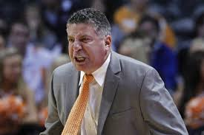

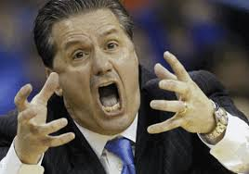
Coach related variables
77 -71 OT
2018-2019 Season Elite 8
Coach Bruce Pearl
Coaching exp: 24 seasons
With Auburn: 5 seasons
Coach John Calipari
Coaching exp: 27 seasons
With Kentucky: 10 seasons

Slide 8
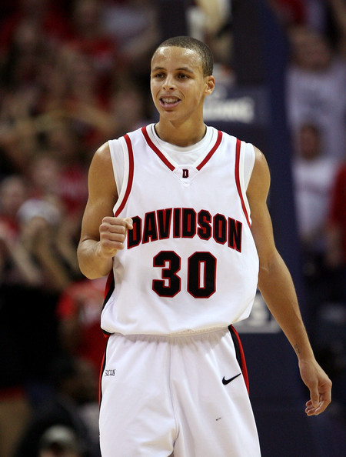
FGA3Prct The percentage of 3-pt field goal attempts in total field goal attempts

Slide 9
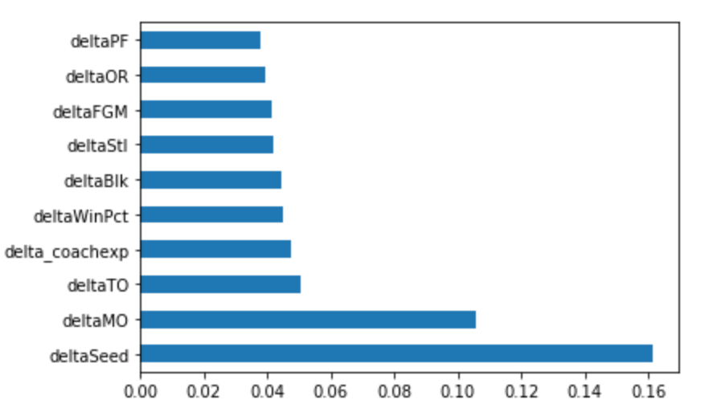
Variable Description
Top 10 Most Important features

Slide 10
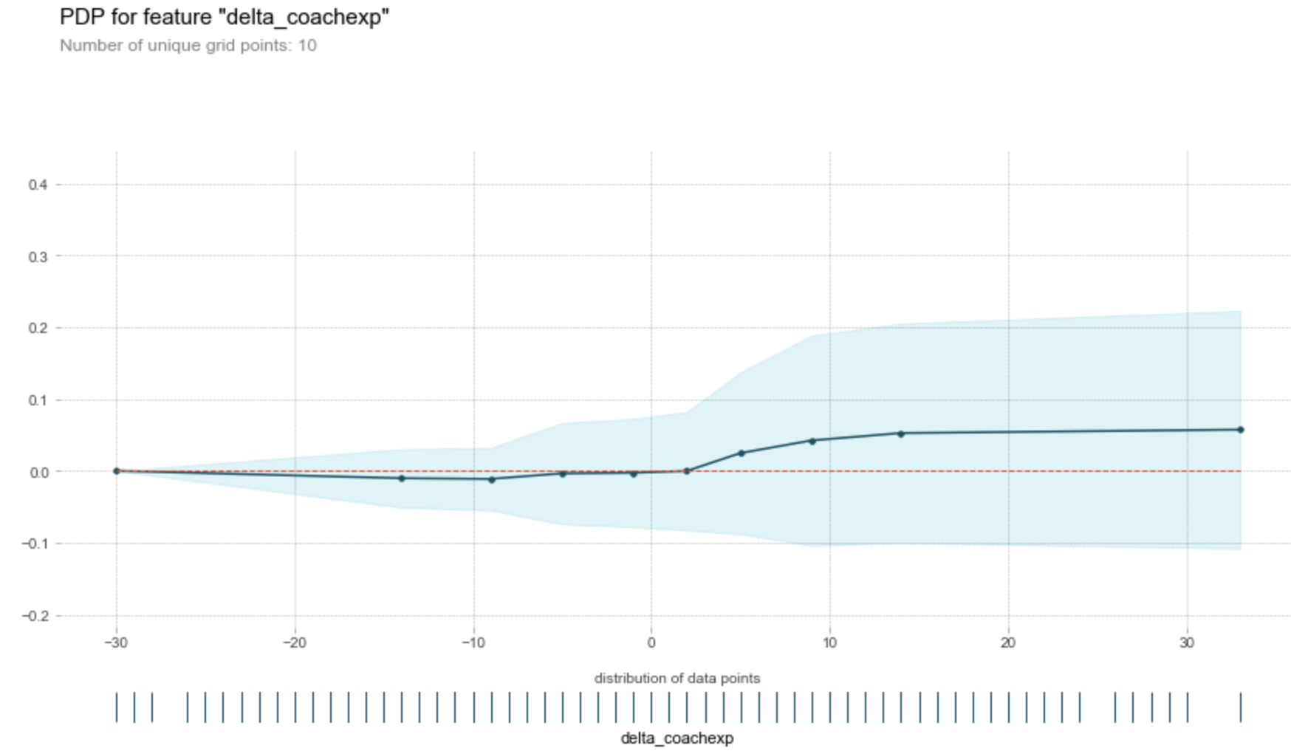
Variable Description
PDP Plot for delta_coachexp

Slide 11
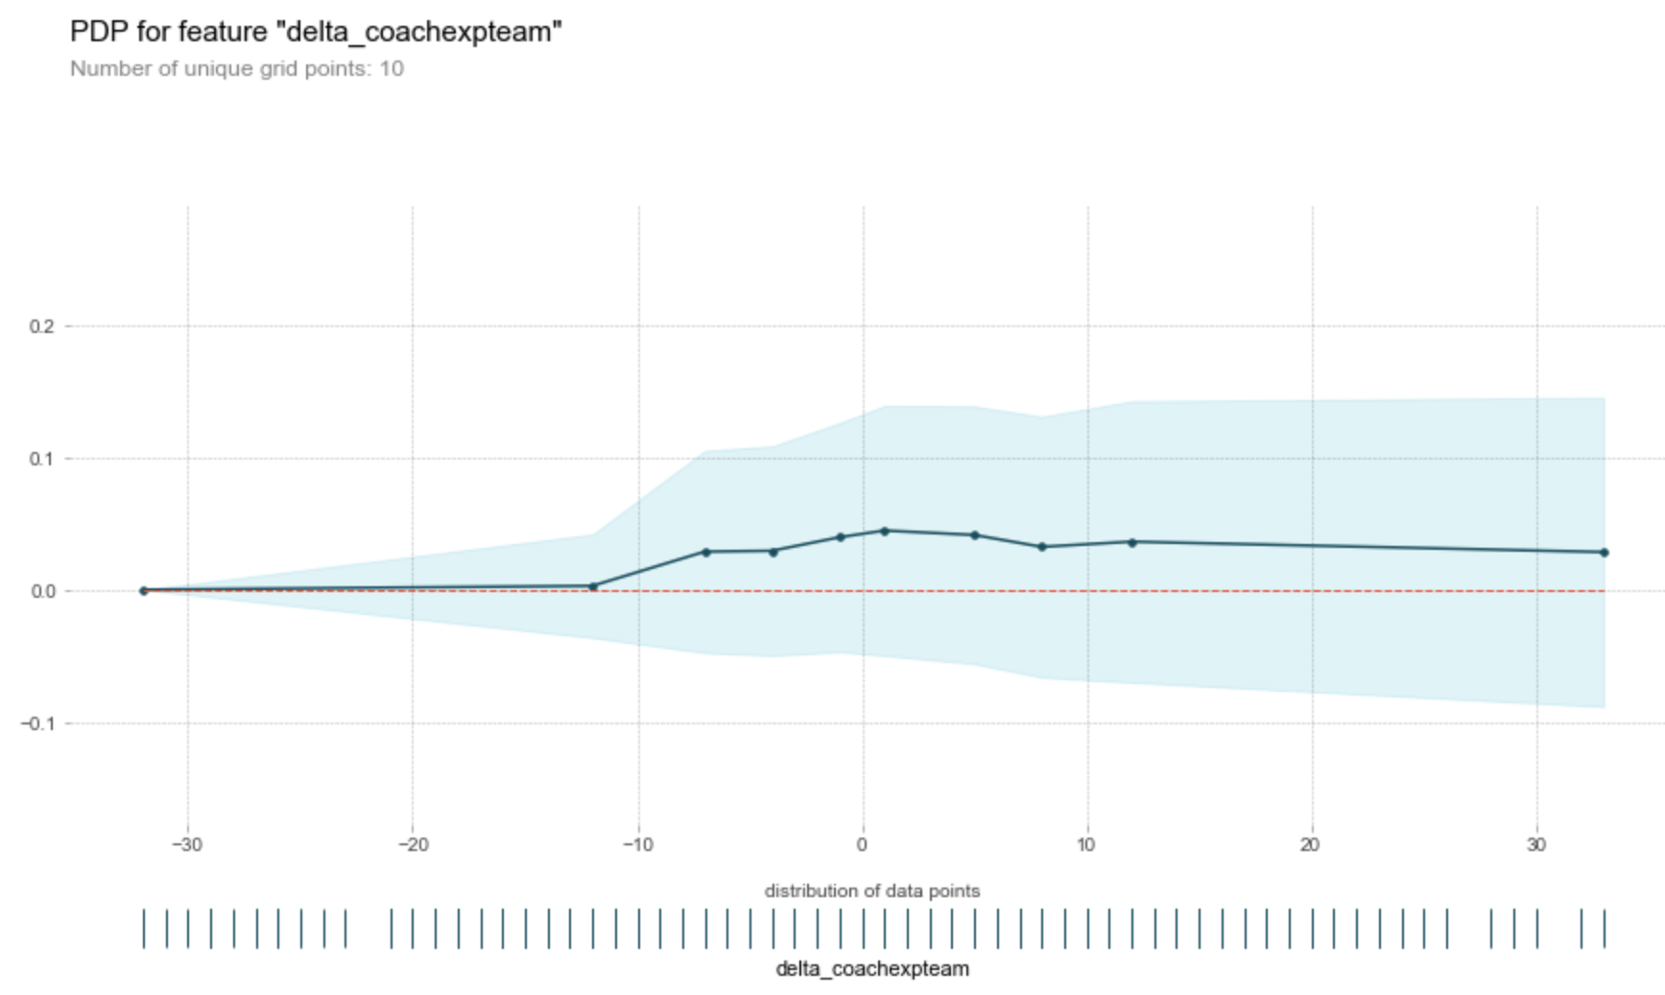
Variable Description
PDP Plot for delta_coachexpteam

Slide 12
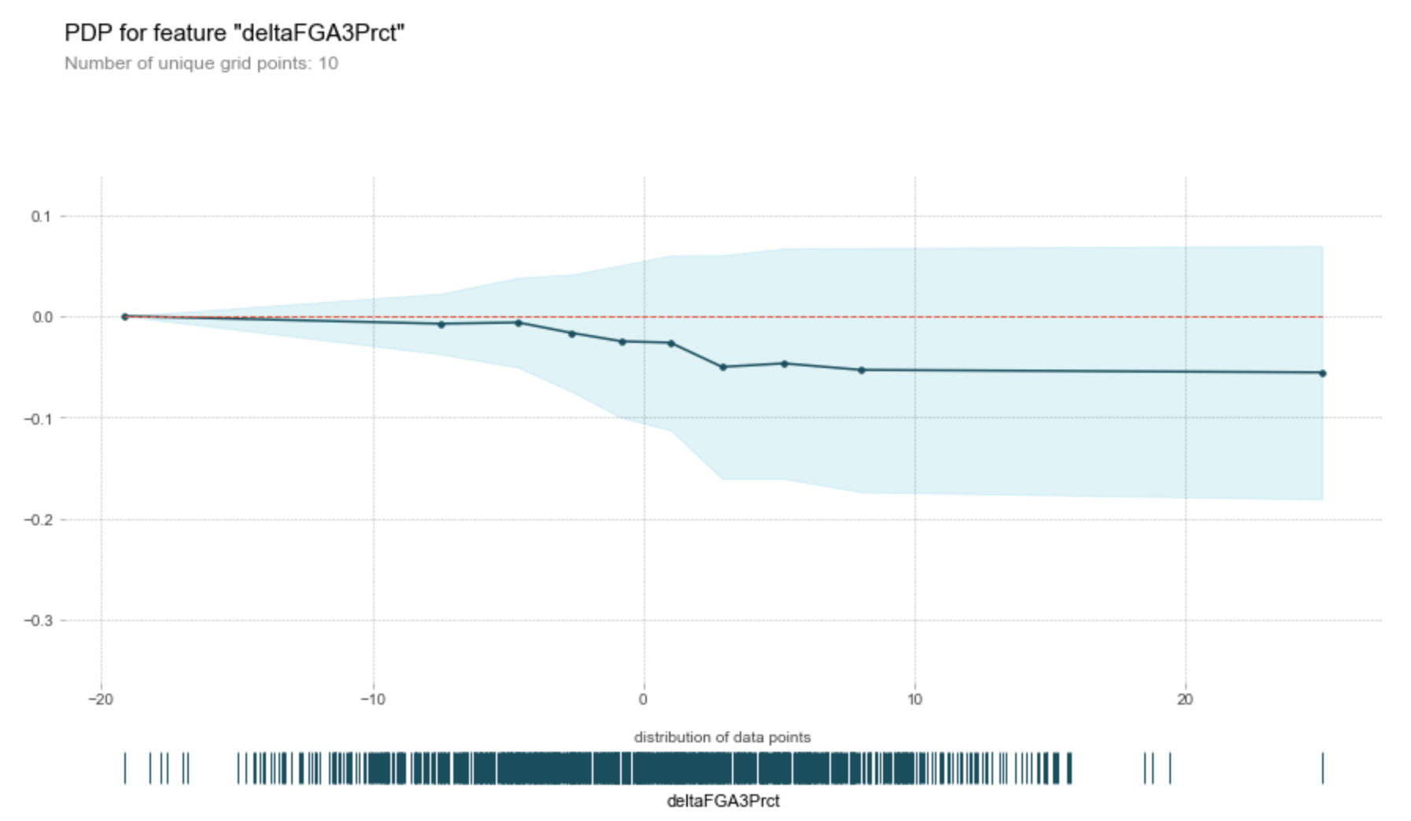
Variable Description
PDP Plot for deltaFGA3Prct

Slide 13
Our Models

Slide 14
Models Selected
Decision Tree Classifier
Random Forest Classifier
Logistic Regression
K-Nearest Neighbors Classifier
Naïve Bayes
Neural Network (MLP: Multilayer Perceptron)
Support Vector Machine

Slide 15
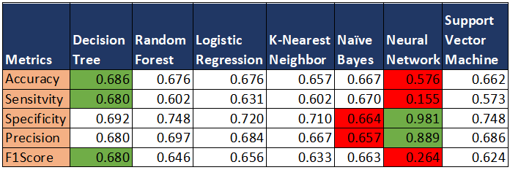
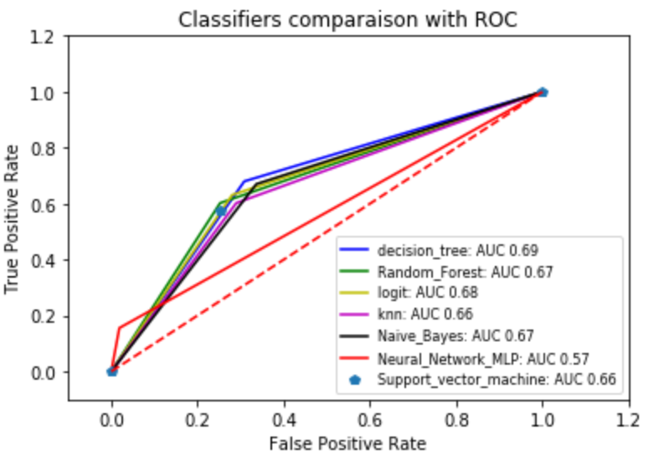
Results Comparison
Decision Tree is the best model

Slide 16
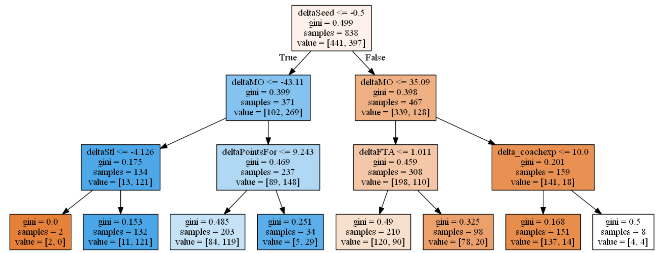
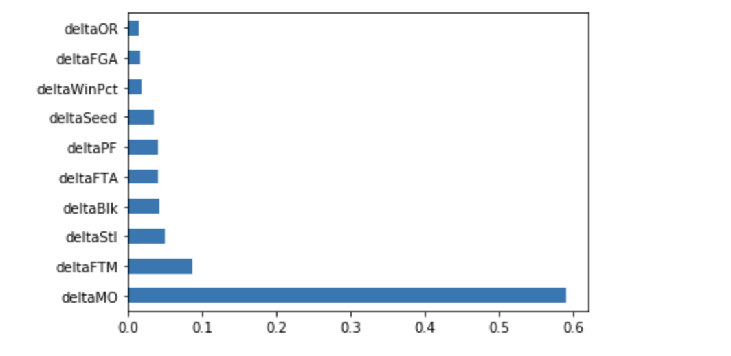
Decision Tree
Highest accuracy at 0.69

Slide 17
Decision Tree

Slide 18
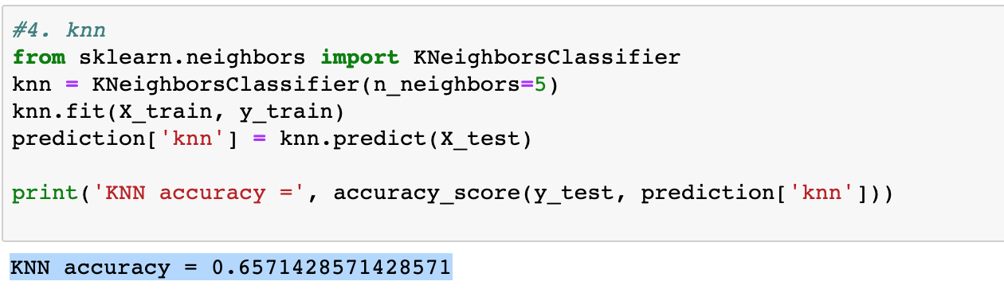
KNN
K nearest neighbors is set to 2，the accuracy value is 0.657143

Slide 19
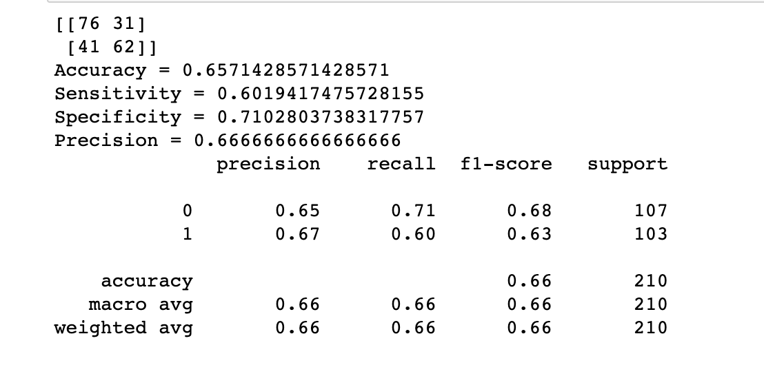
KNN
the AUC score was slightly lower than previous models, at 0.66.
Accuracy, recall and F1-scores are not low compared with other models. This shows that the model can be used to predict values,

Slide 20
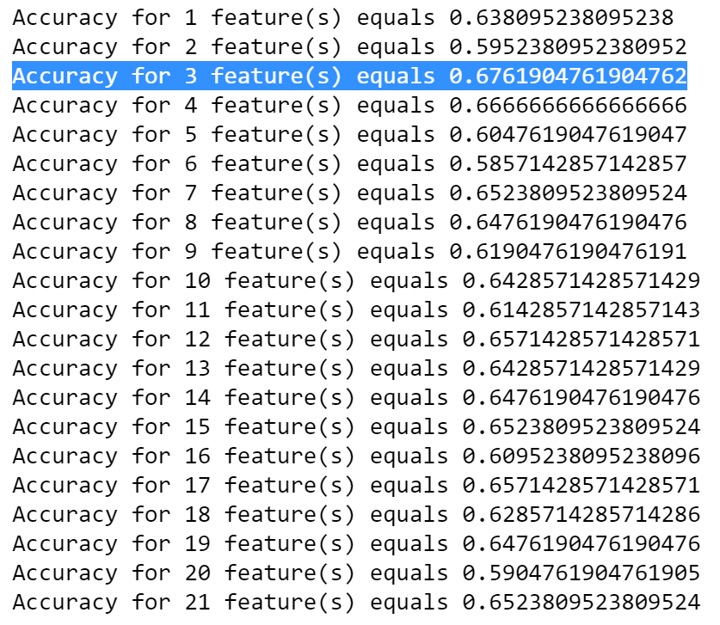
Random Forest Classifier
Possible number of features and corresponding accuracy
Highest accuracy occurs at 3 features

Slide 21
Questions?

Slide 22
Thank you!
Team 14
Robin Wang, Di Yang & Xuanying Zhao
BUAL_5660_Fall_2019

